Slide 1
Graphing Oil and Gas Activity in Texas
Graphed data from 2011 through 2017
Looked at well counts
Gas wells
Oil wells
Looked at point source emissions
NOx
VOC
Summed the data for each of the eight geologic areas of Texas

Slide 2
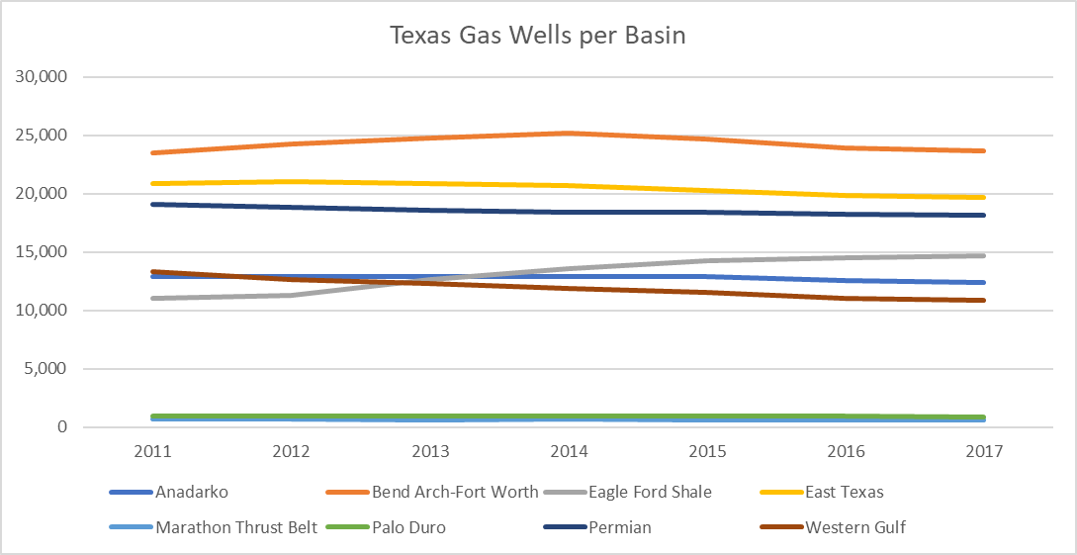
Texas gas wells

Slide 3
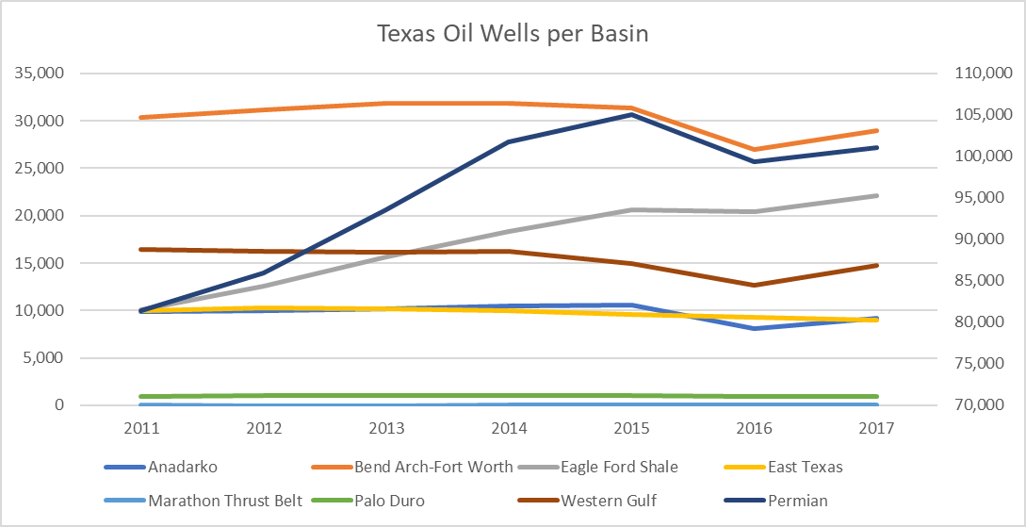
Texas oil wells

Slide 4
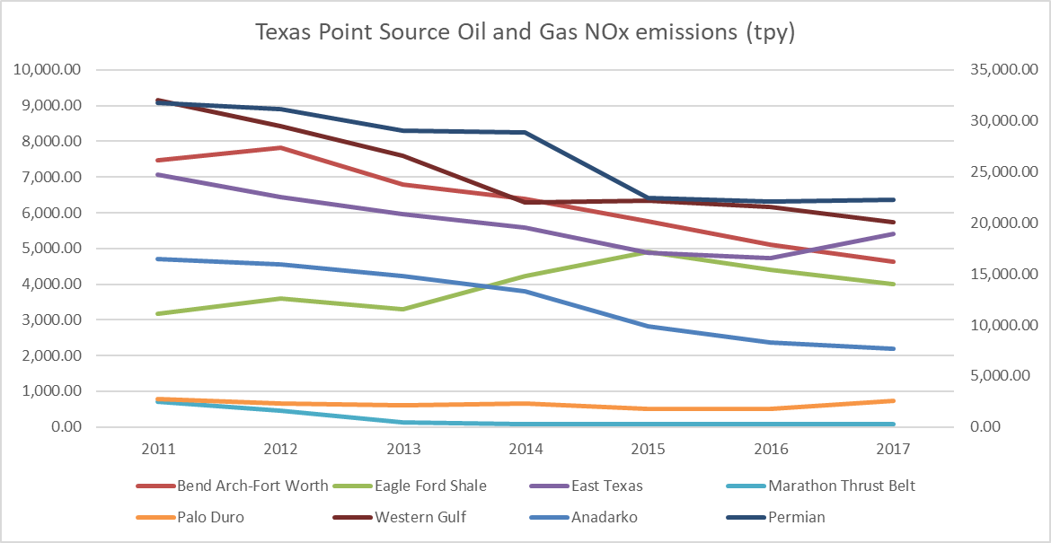
Texas Point Source NOx emissions

Slide 5
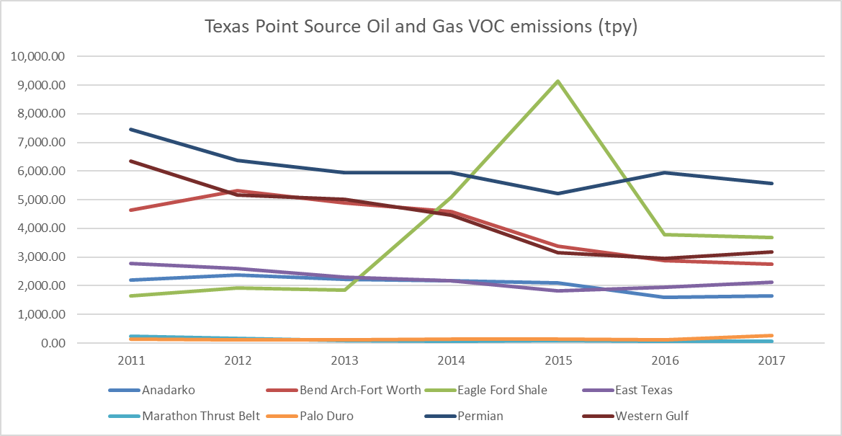
Texas Point Source VOC emissions

Slide 6
Observations
Gas wells
Eagle Ford Shale trending up
All other basins steady or slightly decreasing
Oil wells
Permian Basin and Eagle Ford Shale have been increasing
Other basins steady or decreasing until an uptick in 2017
NOx emissions
Eagle Ford Shale increasing until 2015, then decreasing
All other basins gradually decreasing
VOC emissions
Eagle Ford Shale increasing until 2015, then decreasing
All other basins steady or slightly decreasing

